Slide 1
Deployment Refactoring: PathOS v1.5.1 Decompose the monolith
ken.doig@petermac.org
15 May 2019

Slide 2
The Problem
PathOS module structure has evolved over last 5 years
Multiple ‘products’ in a single GIT repo: PathosCore, Babble, Canary, Amplicon pipeline, etc
Currently all deployed at once
Complex to test
Multiple configurations to be maintained and synched
Very long release cycles
Not best practice
But easy for dependancies…
Need to split out into component parts

Slide 3
Divide and Conquer – decompose the monolith
PathosCore/1.5.1
TAR
JAR
Babble/1.5.1
TAR
JAR
Pathos/1.5.0
Canary/1.0.1
TAR
JAR
WAR
AmpPipe/2.0.0
TAR
JAR
JAR
JAR
Curate/1.5.1
TAR
WAR
JAR

Slide 4
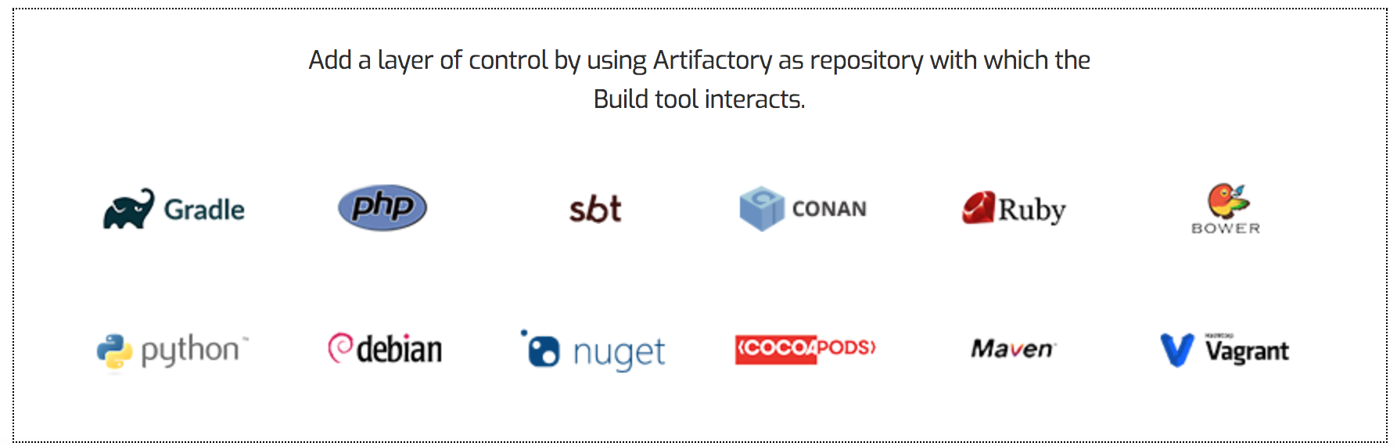

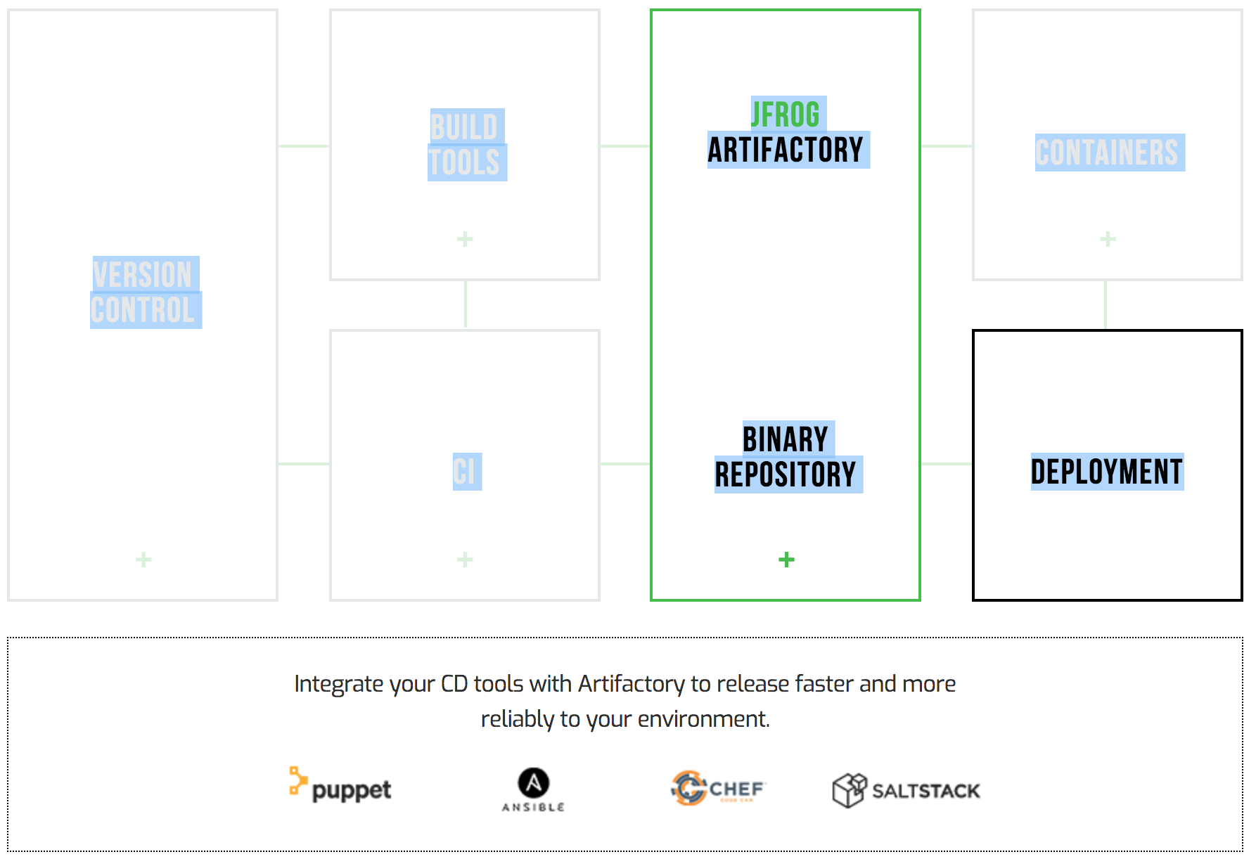


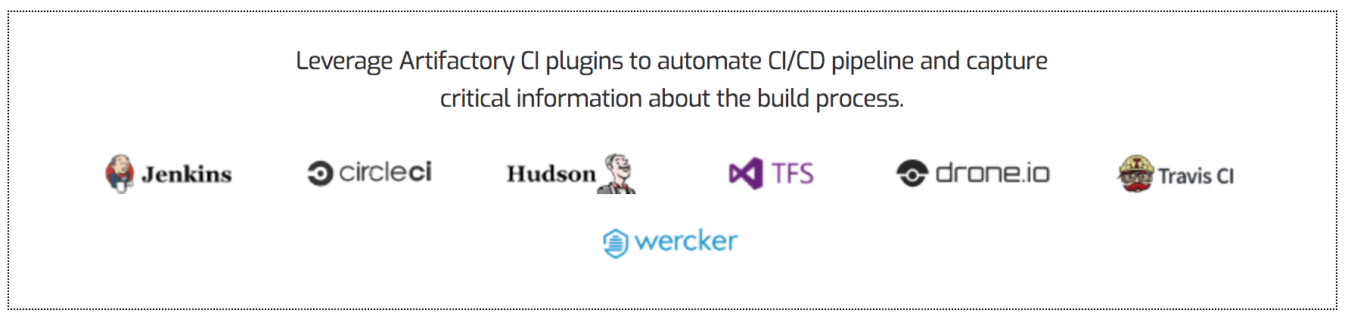

Nexus

Slide 5
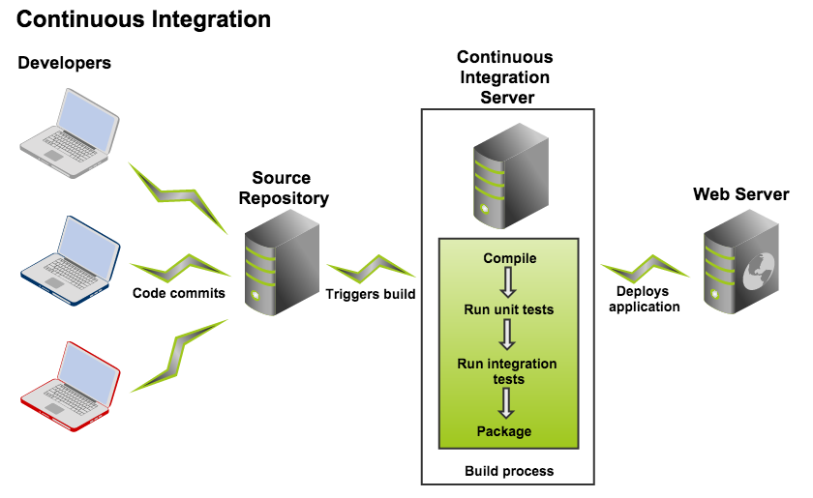
Builds / Continuous Integration

Slide 6
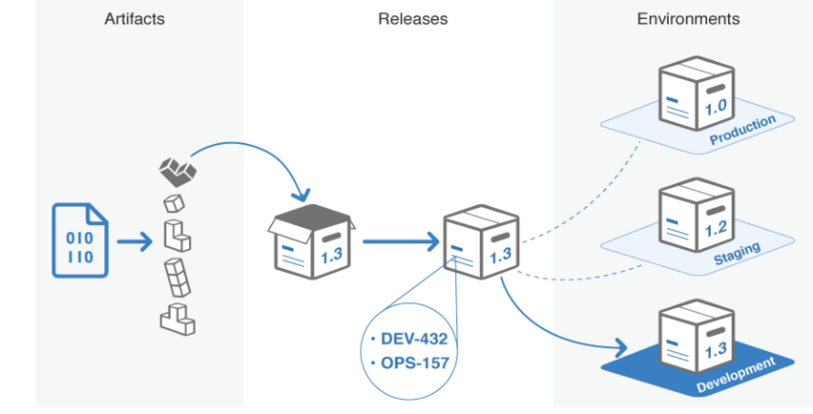
Deployment
Nexus
*.jar
*.tar / *.tgz
*.war
% module load pathos_core/1.5.1
% module load babble/1.5.1
% module load canary/1.0.1
% module load amp_pipe/2.0.0
% module load loader/1.5.1
% module load pathos/pa_prod
% module load pathos/pa_uat
% module load pathos/pa_dev
% module load pathos/pa_trace
% module load pathos/pa_research

Slide 7
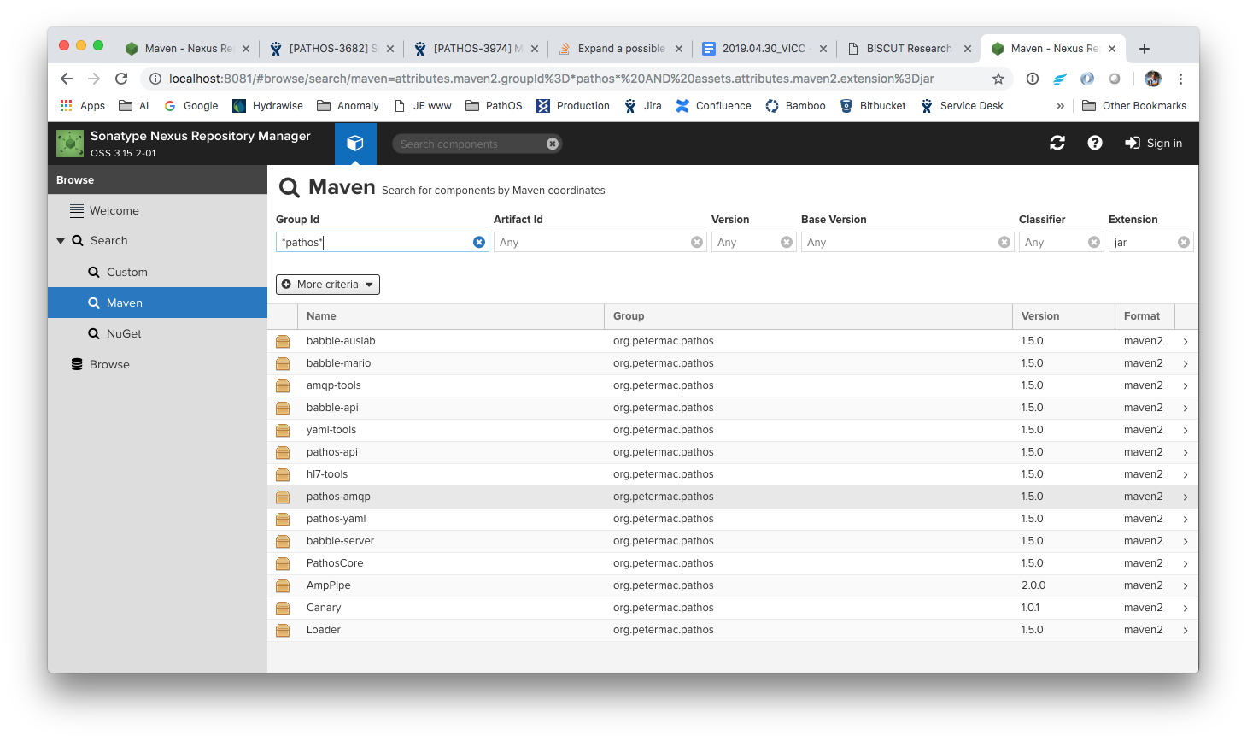

Slide 8
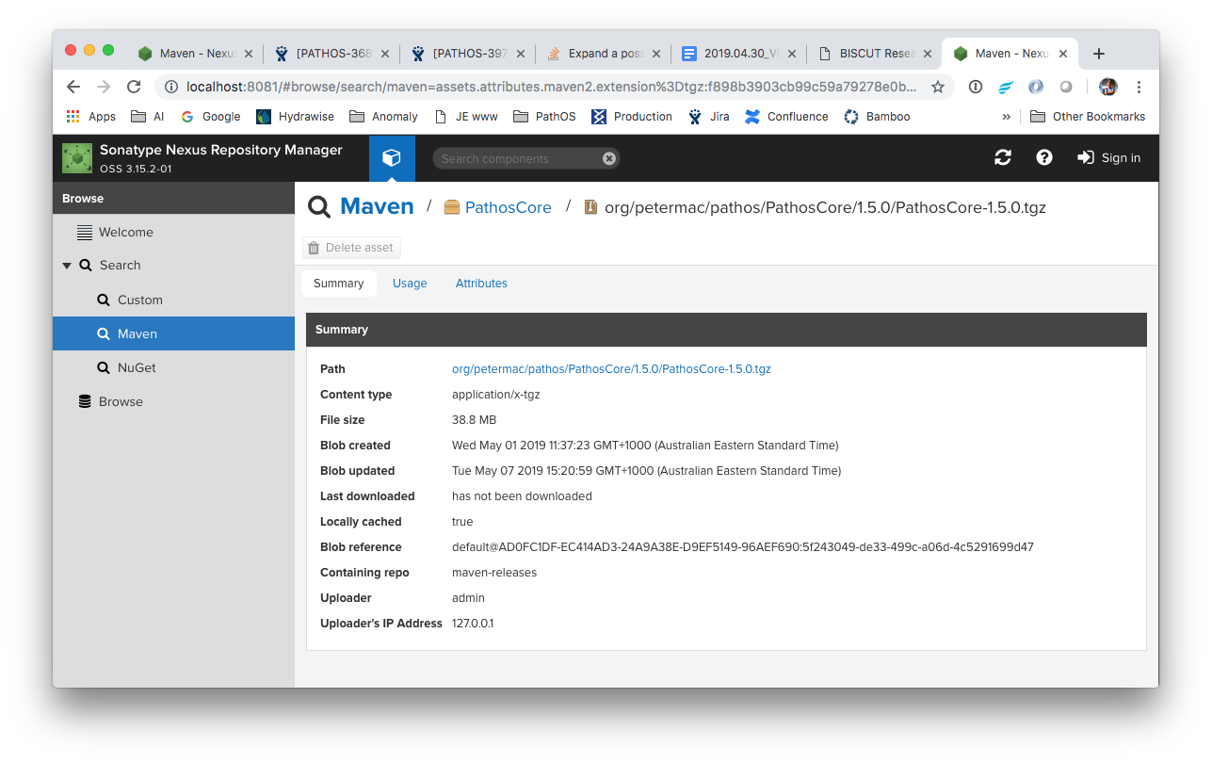

Slide 9
Canary
curl http://localhost:8081/repository/maven-releases/org/petermac/pathos/Canary/1.0.1/Canary-1.0.1.tgz | tar xvzf -
% Total % Received % Xferd Average Speed Time Time Time Current
Dload Upload Total Spent Left Speed
0 0 0 0 0 0 0 0 --:--:-- --:--:-- --:--:-- 0x Canary-1.0.1/
x Canary-1.0.1/bin/
x Canary-1.0.1/bin/Canary
x Canary-1.0.1/etc/
x Canary-1.0.1/etc/canary.properties
x Canary-1.0.1/etc/cols
x Canary-1.0.1/etc/log4j.properties
x Canary-1.0.1/etc/transcript.tsv
x Canary-1.0.1/lib/
x Canary-1.0.1/lib/libsswjni.jnilib
100 38.3M 100 38.3M 0 0 170M 0 --:--:-- --:--:-- --:--:-- 170M

Slide 10
Example Deploy: Canary
Build
Artifacts deposited in artifact repo
tgz
Download from artifact repo
Deploy
Unpack into cluster location /config/binaries
Create module command
% export CANARY_HOME=/config/binaries/Canary/1.0.1
% export PATH=$CANARY_HOME/bin:$PATH
To do:
Formal packages
Eg RPM, Brew, Docker
.properties
Customise configuration
# vi $CANARY_HOME/etc/canary.properties
Run
% module load canary/1.0.1
% Canary --help

Slide 11
Module Setup ?
/config/modulefiles/<module>/<ver>
/config/modulefiles/pathos/pa_<env>
/config/modulefiles/pathos_core/<ver>
/config/modulefiles/babble/<ver>
/config/modulefiles/canary/<ver>
/config/modulefiles/loader/<ver>
/config/modulefiles/amp_pipe/<ver>
% module load pathos/pa_env
set PATHOS_HOME=<install_dir>
prepend-path $PATHOS_HOME/bin
% module load pathos_core/<ver>
set PATHOSCORE_HOME=<install_dir>
prepend-path $PATHOSCORE_HOME/bin
set PATHOS_HOME=${PATHOS_HOME:-$PATHOSCORE_HOME}

